Slide 1
Duck Creek
Introduction, Architecture, And Installation

Slide 2
Overview
Components
Features/Architecture
Important definitions
HTML, XML
Installation Guide
Q&A
Notes:
Execution underpinned by engineering

Slide 3
Overview
As a company -
Duck Creek Technologies is a software and services company that is changing the rules of the insurance business by accelerating the ability to achieve the industry vision of “Product in a Day”(low code tool).
It enables P&C businesses to reimagine, innovate and continuously deliver great result.
Products – Duck Creek Suite consists of following modules
Policy - End to end policy life cycle starting from Quick quote
Rating – This engine is very efficient and used in all premium calculations
Billing – Billing, Invoices, and Payment processing
Claims – Manages entire claim life cycle starting from FNOL
Insights – Reporting and Analytics
Please go through Duck Creek website, to read more about other modules.
Ability to integrate with cloud, aggregators etc.

Slide 4
Components
Example Platform is comprised of following tools:
Example Author
Example Server
Example Express
Example Manuscripts
Example Transact
Example Forms
Example Async

Slide 5
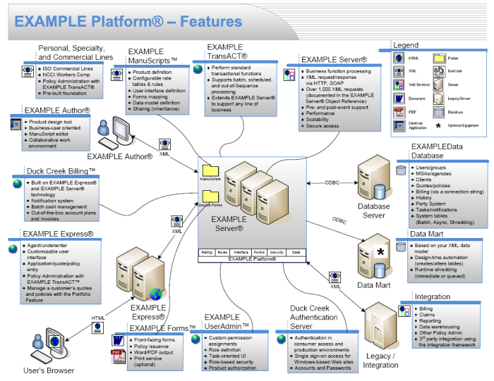
Features

Slide 6
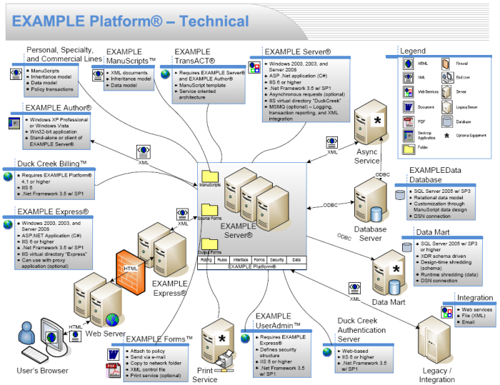
Features

Slide 7
Important Definitions
Web Server
It is a program, which process the network requests of user and serves them files for that web page over HTTP protocol.
Apache HTTP Server
Microsoft Internet Information System
Jigsaw Server
Sun Java System
HTTP Protocol
The HyperText Transfer Protocol (HTTP) is the underlying network protocol that enables transfer of hypermedia documents on the Web, typically between a browser(client) and a server.
URL – Uniform Resource Locator https://www.w3schools.com
http or https →Scheme or Schema →Protocol
http → using same http protocol, but all transfers are unencrypted
https → transfer is taking place over secured channel

Slide 8
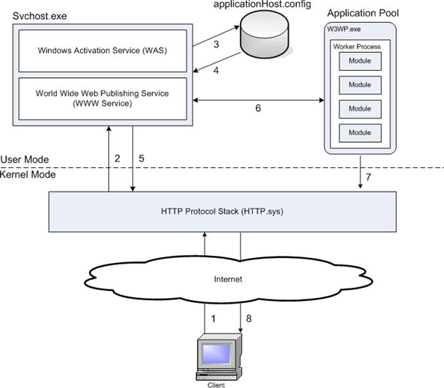
Definitions Contd..
IIS
Internet Information System – Flexible, all purpose
web server which deals with requests processing.
IIS 7 & Later having window process activation service,
which enables sites to use other protocols too apart from
HTTP and HTTPs → Hypertext Transfer Protocol
Any client, sends an http req to IIS, then it process the
req and send response back to client
Introduction to IIS Architectures | Microsoft Learn

Slide 9
HTML, XML and Installation Guide
HTML - HTML Tutorial (w3schools.com)
XML - XML Tutorial (w3schools.com)
Installation Guide
Example platforms
Express – Party, Policy
User Admin
Author
Util

Slide 10
?

Slide 11
Let’s engage!

